Slide 1
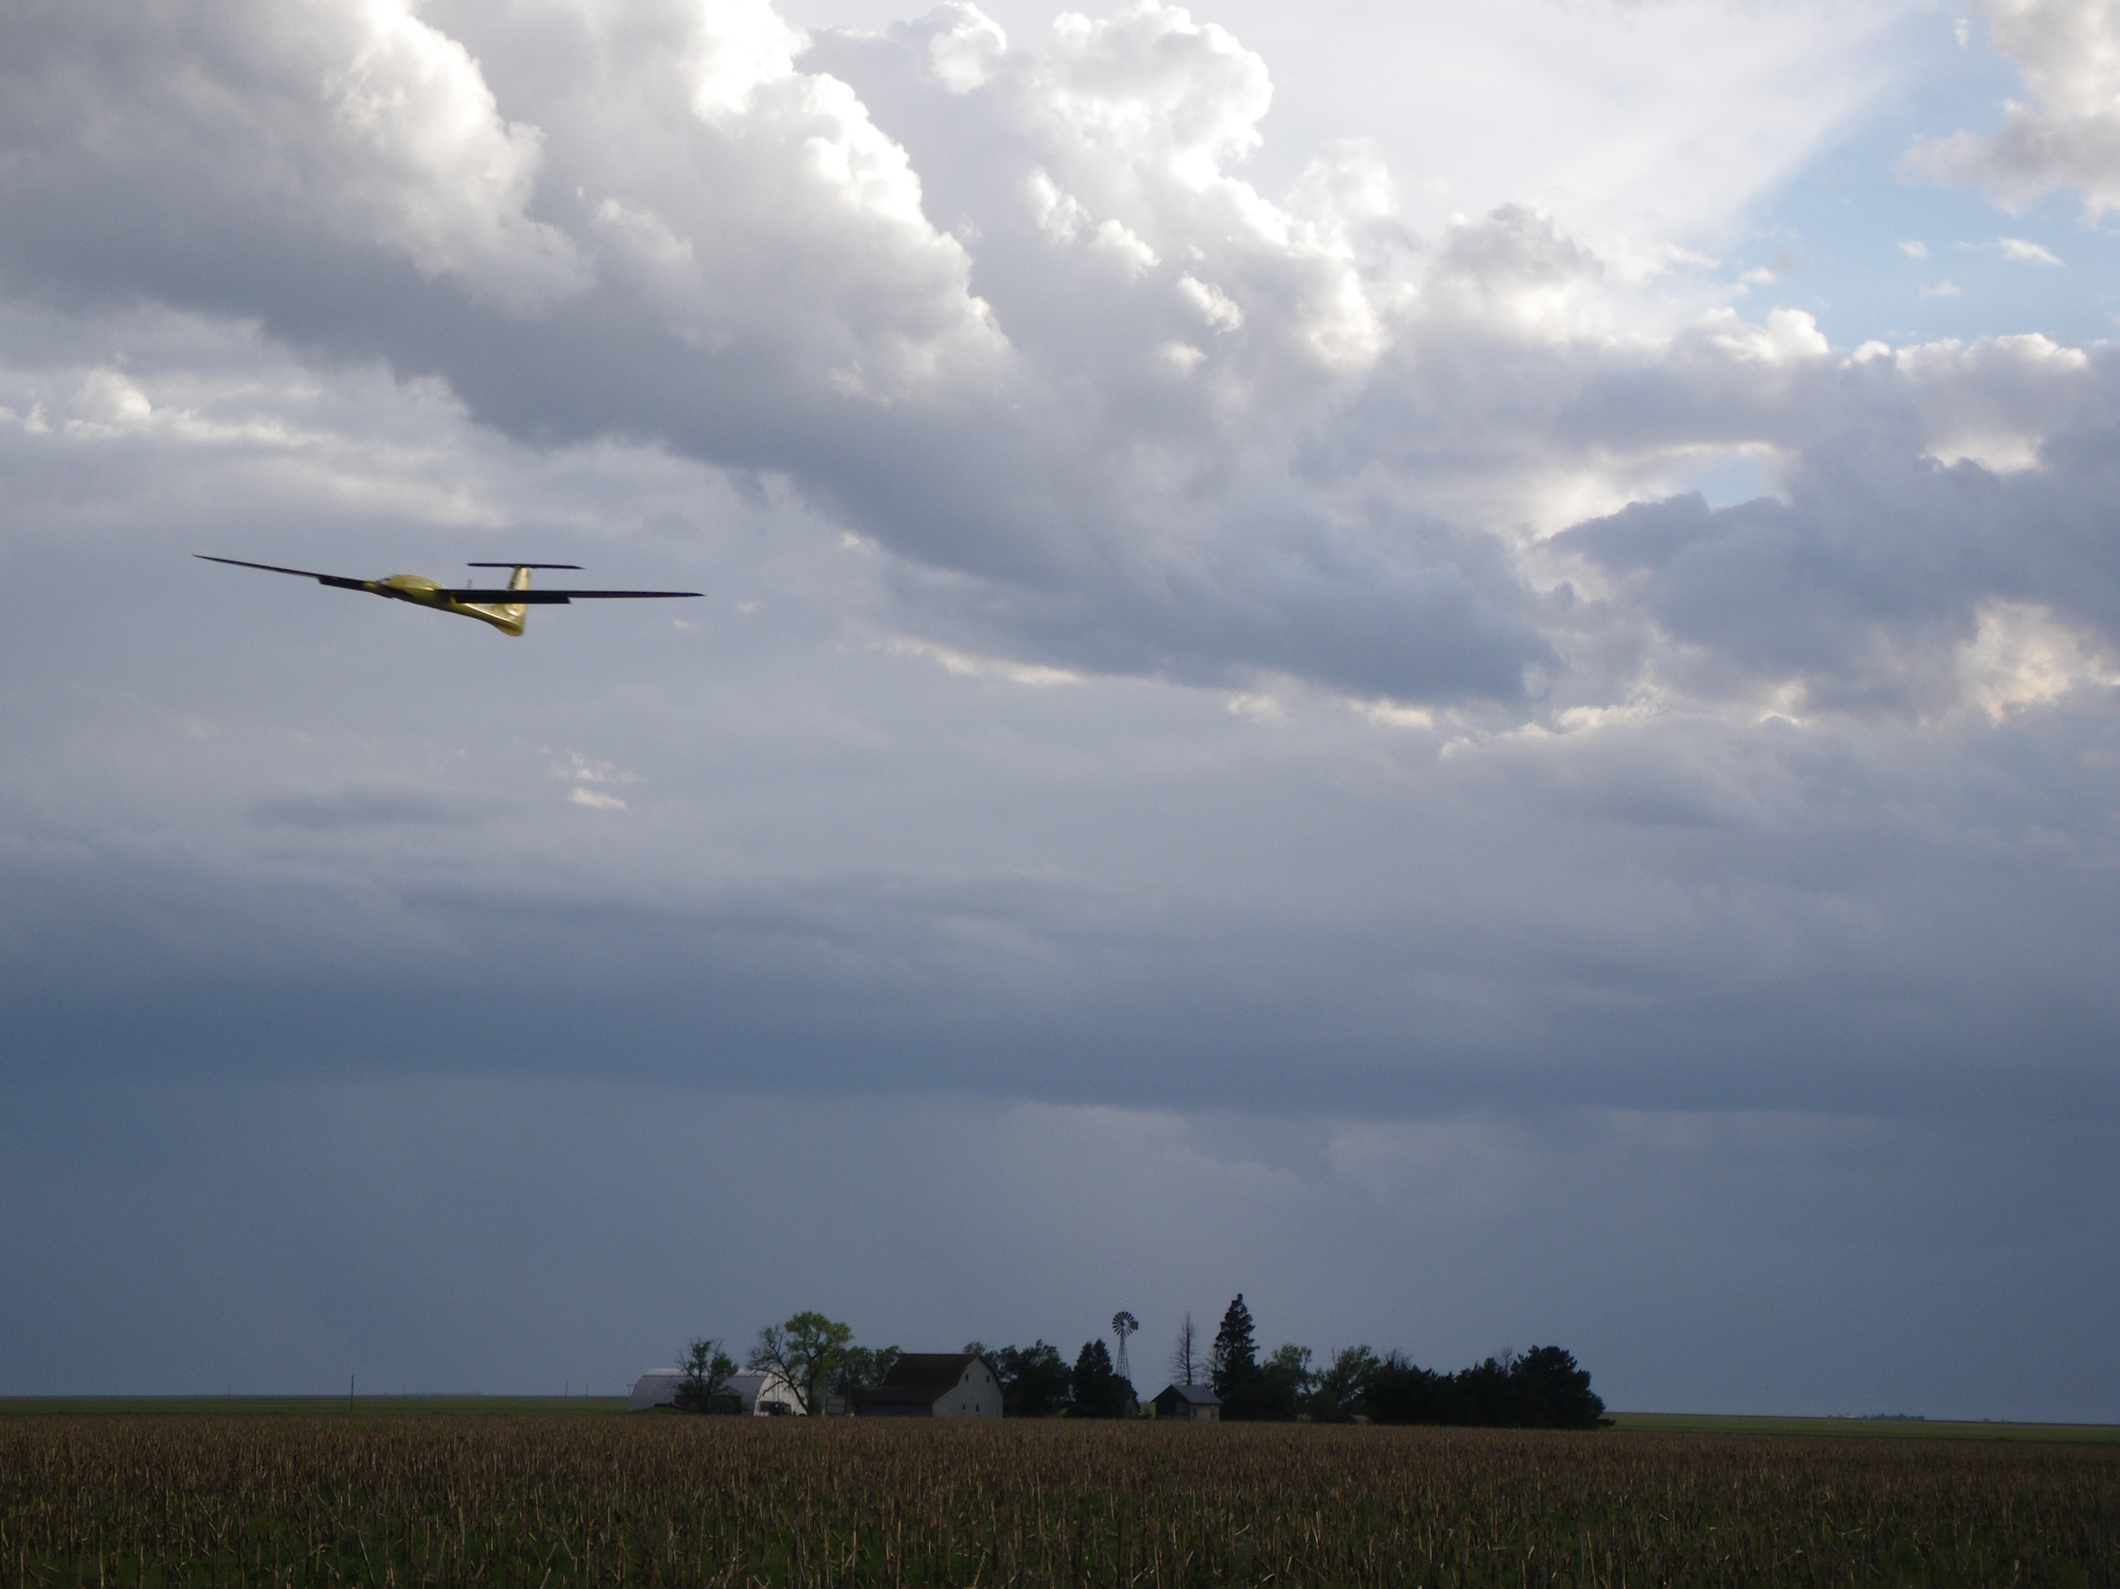
Chapter 7
Sensors

Slide 2
Architecture

Slide 3
Sensors for MAVs
The following types of sensors are commonly used for guidance and control of MAVs
accelerometers
rate gyros
pressure sensors
magnetometers (digital compasses)
GPS

Slide 4
MEMS Accelerometer
Notes:
Newtons $2^{nd}$ law gives
\[
m\ddot{x} = k(y-x)
\]
Note that the acceleration of the proof mass proportional
to deflection of the suspension
Taking the Laplace transform gives
\[
X(s) = \frac{1}{\frac{m}{k}s^2+1} Y(s)
\]
Also, since $X(s)/Y(s)= s^2X(s)/s^2Y(s)$, we can also write
\[
A_X(s) = \frac{1}{\frac{m}{k}s^2+1} A_Y(s)
\]
Accelerometers also have bias and zero mean Gaussian noise. Therefore, the sensor model is
\[
\boxed{\Upsilon_{\text{accel}} = k_{\text{accel}} a + \beta_{\text{accel}} + \eta_{\text{accel}}’.}
\]

Slide 5
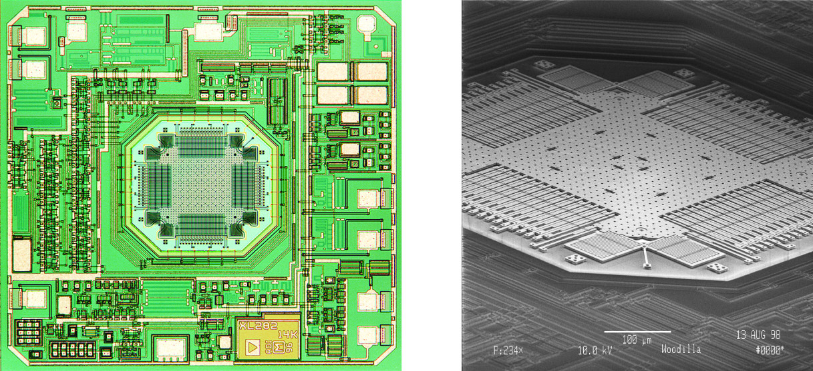
MEMS Accelerometer

Slide 6
Acceleration Measurement
Tricky concept: Measured acceleration is the total acceleration of the accelerometer
casing minus the acceleration of gravity
Example: Set the accelerometer on a table top.
What does it measure?
Accels measure components of linear, coriolis, and externally applied acceleration.
They do not measure gravity, since both the proof mass and the casing are acted on by gravity in exactly the same way
Notes:
\mathbf{a} = \frac{1}{\mass}\left(\mathbf{F}_{\text{total}} - \mathbf{F}_{\text{gravity}}\right)

Slide 7
Acceleration Measurement
Said another way, accelerometers measure specific force, which is defined as the
sum of the non-gravitational forces divided by the mass
Example: Set the accelerometer on a table top.
What does it measure?
Hint: (Draw FBD of accel housing)
Notes:
\mathbf{a}_{\text{measured}} &= \frac{1}{\mass}\left(\sum\mathbf{F}_{\text{non-gravitational}}
\right) \\
&=\frac{1}{\mass}\left(\sum\mathbf{F} - \mathbf{F}_{\text{gravitational}}
\right)

Slide 8
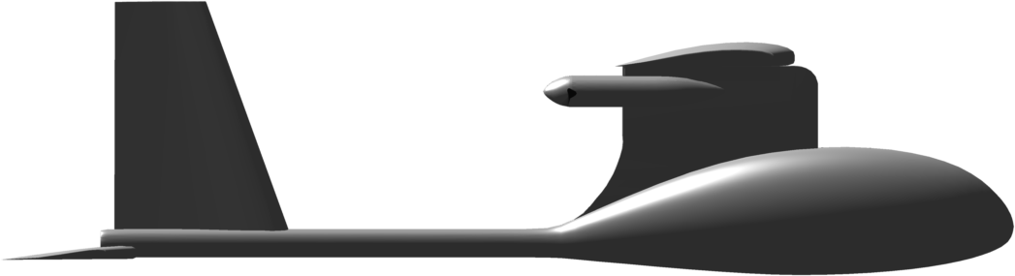
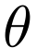
Acceleration on Fixed-Wing Aircraft
Notes:
\mathbf{a}_{\text{measured}} &= \frac{1}{\mass}\left(\mathbf{F}_{\text{total}} - \mathbf{F}_{\text{gravity}}\right) \\
&= \frac{1}{\mass}\left( \left(\mathbf{F}_{\text{lift}}+\mathbf{F}_{\text{drag}}+\mathbf{F}_{\text{thrust}}+\mathbf{F}_{\text{gravity}}\right) - \mathbf{F}_{\text{gravity}}\right) \\
&= \frac{1}{\mass}\left( \mathbf{F}_{\text{lift}}+\mathbf{F}_{\text{drag}}+\mathbf{F}_{\text{thrust}}\right)

Slide 9
Acceleration on Fixed-Wing Aircraft
Notes:
\par\noindent Recall from Chapter 3, that
\[
\mass\left(\frac{d\mathbf{v}}{dt_b} + \boldsymbol{\omega}_{b/i}\times\mathbf{v}\right)
= \mathbf{F}_{\text{total}}.
\]
Using the expression
\[
\mathbf{a}_\text{measured} = \frac{1}{\mass}\left(\mathbf{F}_{\text{total}} - \mathbf{F}_{\text{gravity}}\right),
\]
the output of the accelerometer can be expressed as
\[
\mathbf{a}_\text{measured} = \frac{d\mathbf{v}}{dt_b} + \boldsymbol{\omega}_{b/i}\times\mathbf{v} - \frac{1}{\mass}\mathbf{F}_{\text{gravity}}.
\]
Expressing this relationship in the body frame gives
\begin{align*}
a_x &= \dot{u} + qw-rv + g\sin\theta \\
a_y &= \dot{v} + ru-pw - g\cos\theta\sin\phi \\
a_z &= \dot{w} + pv-qu - g\cos\theta\cos\phi
\end{align*}

Slide 10
Accelerometer Models
Notes:
\usepackage{empheq}
\begin{empheq}[box=\fbox]{align}
y_{\text{accel},x} &= \dot{u} + qw-rv + g\sin\theta + \eta_{\text{accel},x} \nonumber \\
y_{\text{accel},y} &= \dot{v} + ru-pw - g\cos\theta\sin\phi + \eta_{\text{accel},y} \nonumber \\
y_{\text{accel},z} &= \dot{w} + pv-qu - g\cos\theta\cos\phi + \eta_{\text{accel},z} \nonumber
\end{empheq}
or
\begin{empheq}[box=\fbox]{align}
y_{{\rm accel},x} &=\frac{\rho V_a^2 S}{2\mass} \left[C_{X} (\alpha)+ C_{X_{q}} (\alpha) \frac{\bar{c} q}{2 V_a}
+ C_{X_{\delta_e}}(\alpha) \delta_e\right]\nonumber\\
&\quad+ \frac{\rho S_{{\rm prop}}C_{{\rm prop}}}{2\mass} [(k_{{\rm motor}}\delta_t)^2-V_a^2]+ \eta_{{\rm accel},x} \nonumber\\
y_{{\rm accel},y} &=\frac{\rho V_a^2 S}{2\mass}\left[C_{Y_0} + C_{Y_{\beta}} \beta + C_{Y_p} \frac{b p}{2V_a} + C_{Y_r}
\frac{br}{2V_a}\right.\nonumber\\
&\quad+\left. C_{Y_{\delta_a}} \delta_a + C_{Y_{\delta_r}} \delta_r\vphantom{\int}\right]+ \eta_{{\rm accel},y} \nonumber\\
y_{{\rm accel},z} &=\frac{\rho V_a^2 S}{2\mass} \left[C_{Z}(\alpha)+ C_{Z_{q}}(\alpha) \frac{\bar{c} q}{2 V_a}+ C_{Z_{\delta_e}}(\alpha) \delta_e\right]+ \eta_{{\rm accel},z}\nonumber
\end{empheq}

Slide 11
Accelerometer Models
Notes:
or
\begin{empheq}[box=\fbox]{align}
y_{\text{accel},x} &= \frac{f_x}{\mass} + g\sin\theta + \eta_{\text{accel},x} \nonumber \\
y_{\text{accel},y} &= \frac{f_y}{\mass} - g\cos\theta\sin\phi + \eta_{\text{accel},y} \label{eq:sensors-accelerometers-2} \nonumber\\
y_{\text{accel},z} &= \frac{f_z}{\mass} - g\cos\theta\cos\phi + \eta_{\text{accel},z}\nonumber
\end{empheq}

Slide 12
MEMS Rate Gyro
Notes:
Point translating on a rotating rigid body
experiences a coriolis acceleration:
\[
\abf_C = 2\Omegabf \times \vbf
\]
MEMS rate gyro – resonating proof mass:
\[
|\vbf| = A\omega_n\sin(\omega_n t)
\]
---
Sensor measures deflection of proof mass due to coriolis acceleration
\begin{align*}
V_{\text{gyro}} &= k_C |\abf_C| \\
&= 2 k_C |\Omegabf \times \vbf| \\
&= 2 k_C \Omega |\vbf|\\
&= 2 k_C \Omega |A\omega_n\sin(\omega_n t)| \\
&= 2 k_C A \omega_n \Omega\\
&= k_{\text{gyro}} \Omega, \qquad \text{where~} k_{\text{gyro}} = 2k_c A \omega_n
\end{align*}

Slide 13
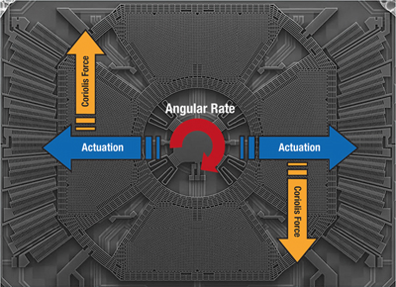
MEMS Rate Gyro

Slide 14
Rate Gyro Model
Notes:
The manufacturing process implies that rate gyros will have a drift term, as well as zero mean Gaussian noise:
\[
\Upsilon_{\text{gyro}} = k_{\text{gyro}} \Omega + \beta_{\text{gyro}} + \eta_{\text{gyro}}’,
\]
where $\Upsilon_{\text{gyro}}$ is in units of voltage. Calibrating to units of rad/s gives
\begin{empheq}[box=\fbox]{align}
y_{\text{gyro},x} &= p + \beta_{\text{gyro},x} + \eta_{\text{gyro},x} \nonumber \\
y_{\text{gyro},y} &= q + \beta_{\text{gyro},y} + \eta_{\text{gyro},y} \nonumber\\
y_{\text{gyro},z} &= r + \beta_{\text{gyro},z} + \eta_{\text{gyro},z} \nonumber
\end{empheq}

Slide 15
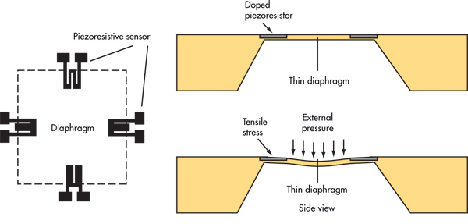
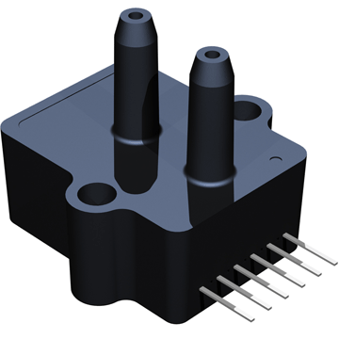
Pressure Measurement

Slide 16
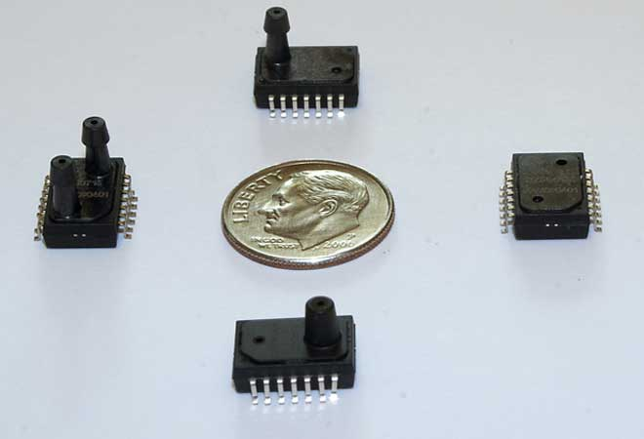
Pressure Measurement

Slide 17
Altitude Measurement
Notes:
The basic equation of hydrostatics is
\[
P_2 - P_1 = \rho g (z_2 - z_1)
\]
Using the ground as reference, and assuming constant air density gives
\begin{align*}
P-P_{\text{ground}}
&=-\rho g (h-h_{\text{ground}}) \\
&=-\rho g h_{\text{AGL}}\
\end{align*}
Below 11,000 m, can use barometric formula:
\[
P = P_0 \left[ \frac{T_0}{T_0+L_0 h_{\text{ASL}}} \right] ^\frac{g M}{R L_0},
\]
where
\noindent
$P_0$: standard pressure at sea level \\
$T_0$: standard temperature at sea level \\
$L_0$: rate of temperature decrease \\
$g$: gravitational constant \\
$R$: universal gas constant for air \\
$M$: standard molar mass of atmospheric air, \\ \\
which takes into account change in density with altitude and temperature.

Slide 18
Altitude Measurement
Notes:
\noindent We usually assume density is constant:
\begin{align*}
y_{\text{abs pres}} &= (P_{\text{ground}} - P) + \beta_{\text{abs pres}} + \eta_{\text{abs pres}} \notag \\
&= \rho g h_{\text{AGL}} + \beta_{\text{abs pres}} + \eta_{\text{abs pres}}
\end{align*}
Is this valid?

Slide 19
Airspeed Measurement
Notes:
\noindent From Bernoulli's equation:
\[
P_t = P_s + \frac{\rho V_a^2}{2}
\qquad \text{~or~} \qquad
\frac{\rho V_a^2}{2} = P_t - P_s
\]
Pitot-static pressure sensor measures dynamic pressure:
\[
y_{\text{diff pres}} = \frac{\rho V_a^2}{2} + \beta_{\text{diff pres}} + \eta_{\text{diff pres}}
\]

Slide 20
Magnetometer
north
magnetic
north
declination
local
magnetic
field
Notes:
Let $\mathbf{e}_1 = (1, 0, 0)^\top$ be a unit vector pointing north.
Let $R(0, -\iota, \delta)$ be the rotation matrix from the
magnetic frame to the inertial frame. Then
\[
\mathbf{m}^i = R^\top(0, -\iota, \delta) \mathbf{e}_1
\]
is the unit vector that points in the direction of the magetic field, resolved in the inertial frame.
The normalized magnetic field measured in the body frame is
\[
\mathbf{m}^b = R_b^{i\top} \mathbf{m}^i.
\]
The measurement is given by
\[
y_{mag} = \mathbf{m}^b + \boldsymbol{\eta}.
\]

Slide 21
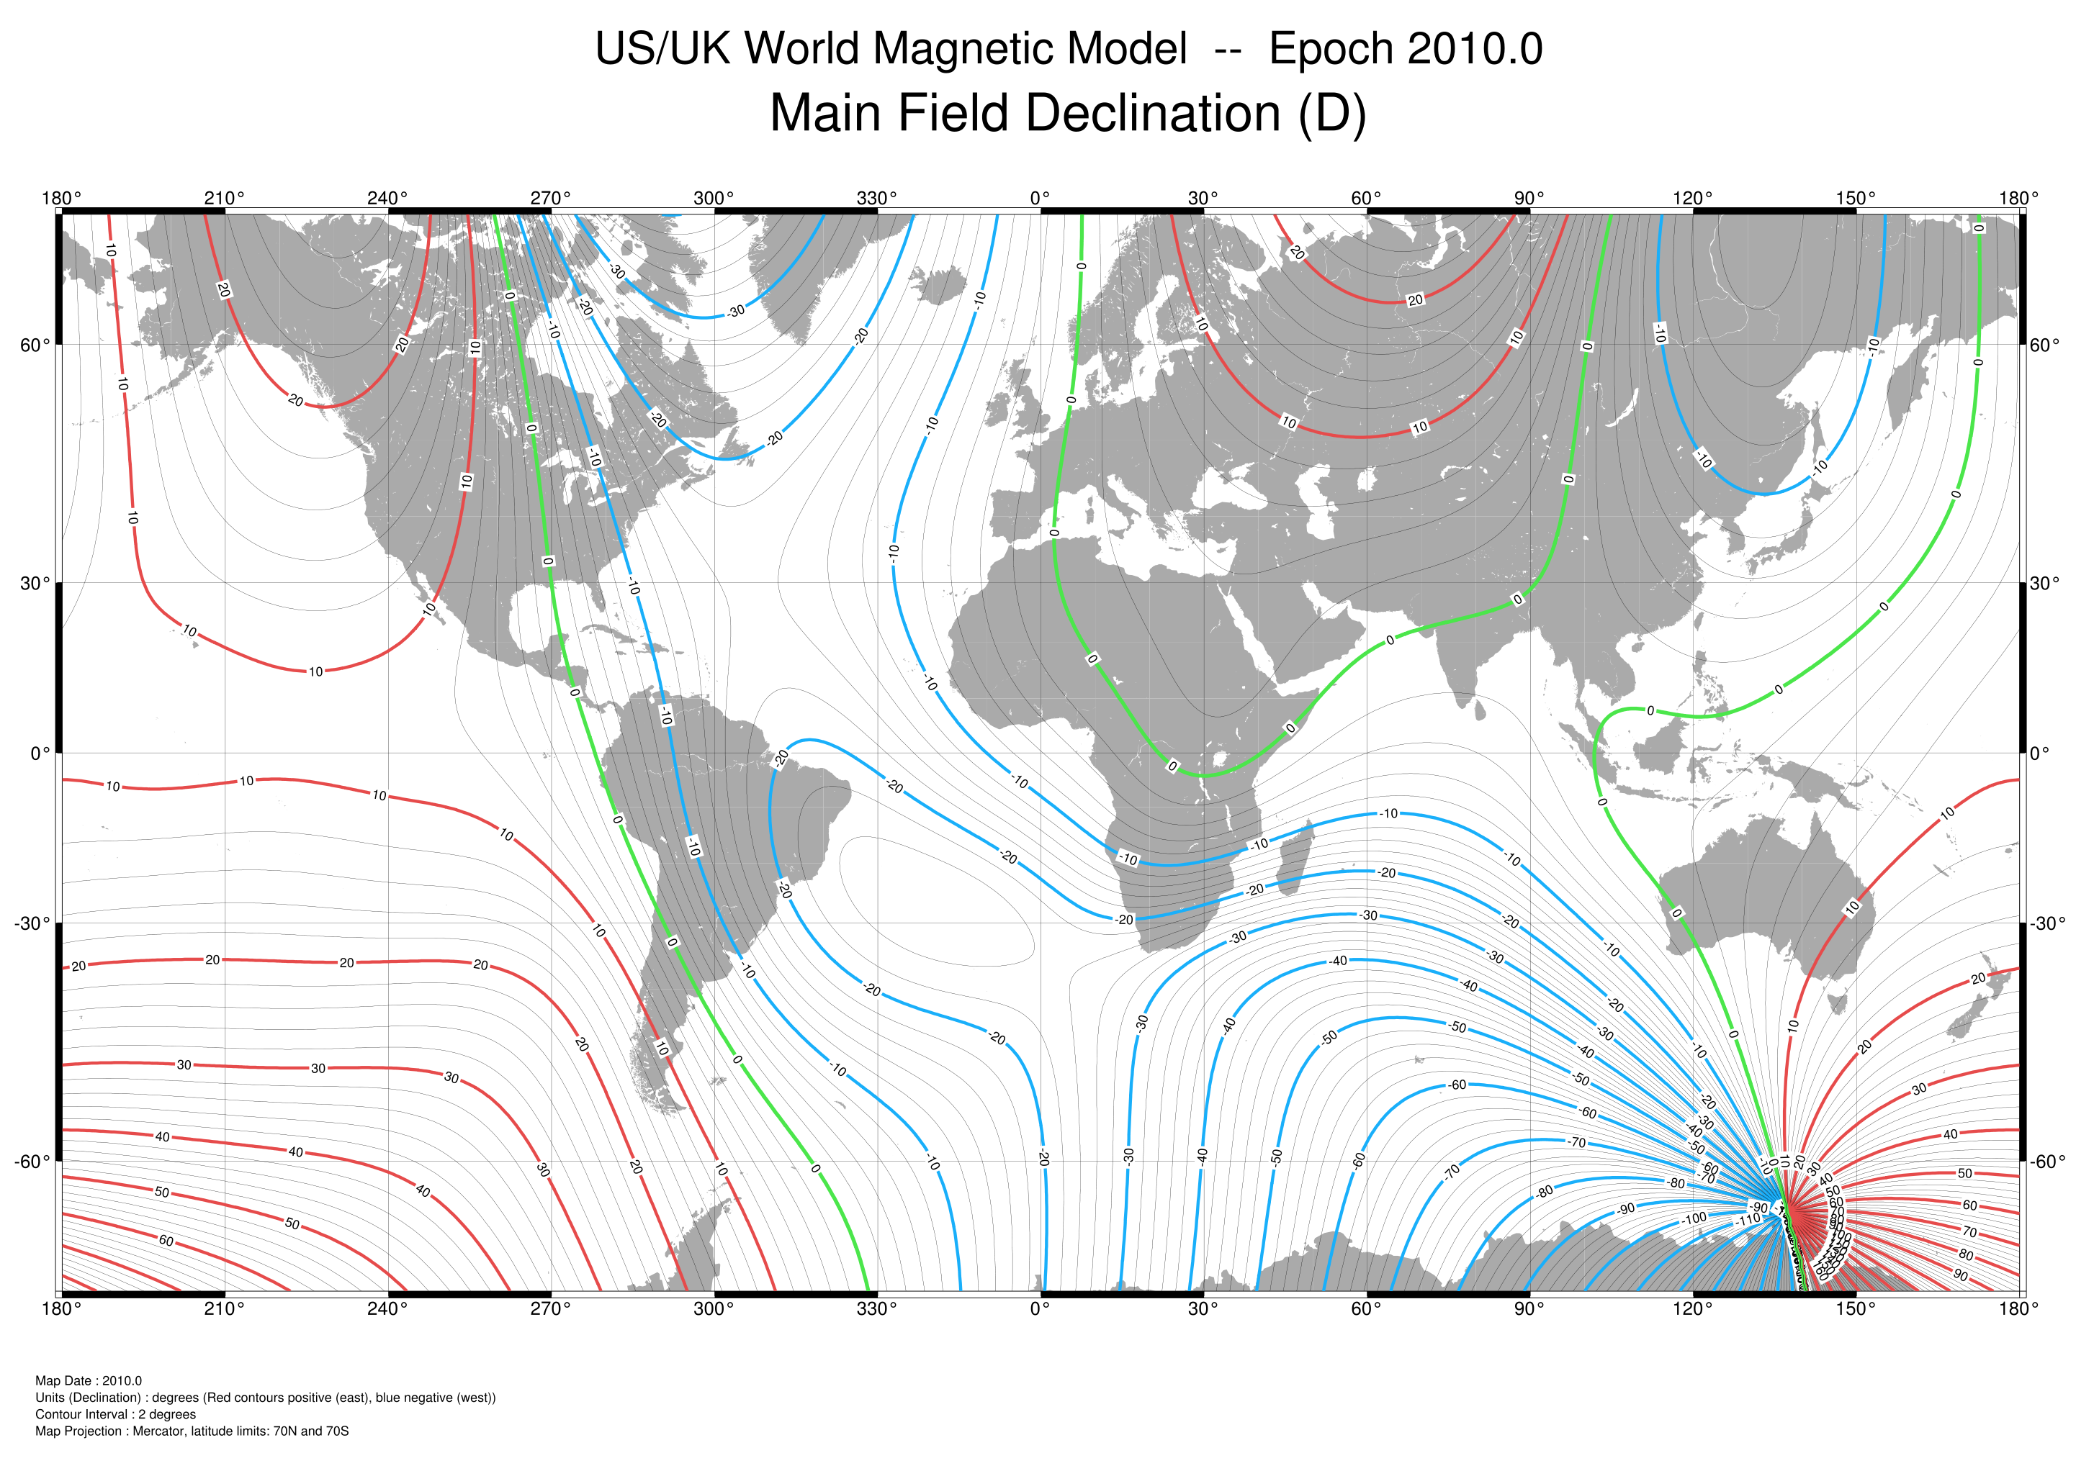
Magnetic Declination Variation
180°
210°
240°
270°
300°
330°
0°
30°
60°
90°
120°
150°
180°
60°
-30
20
60°
20
-10
0
10
-20
-10
30°
-10
30°
0
10
0
0
0°
0°
10
-20
-10
-30°
-30°
20
-20
-30
-40
-50
10
20
30
-10
30
-60°
40
-60
40
-60°
-70
-80
50
50
-90
60
60
180°
210°
240°
270°
300°
330°
0°
30°
60°
90°
120°
150°
180°
World Magnetic Model, National Geophysical Data Center
Magnetic declination in Provo Utah is 12.5 degrees

Slide 22
Magnetic Inclination
From Wikipedia: "Magnetic dip or magnetic inclination is the angle made by a compass needle with the horizontal at any point on the Earth's surface. Positive values of inclination indicate that the field is pointing downward, into the Earth, at the point of measurement.
Magnetic inclination in Provo Utah is 66 degrees

Slide 23
Digital Compass
north
magnetic
north
declination
local
magnetic
field
Notes:
\noindent Heading is sum of magnetic declination angle and magnetic heading
\[
\psi = \delta + \psi_m
\]
Magnetic heading determined from measurements of body-frame components of magnetic field projected onto horizontal plane
\begin{align*}
\mathbf{m}^{v1} = \begin{pmatrix} m_{x}^{v1} \\ m_{y}^{v1} \\ m_{z}^{v1} \end{pmatrix}
&= \mathcal{R}_{b}^{v1}(\phi,\theta) \mathbf{m}^b \notag \\
&= \mathcal{R}_{v2}^{v1}(\theta) \mathcal{R}_{b}^{v2}(\phi) \mathbf{m}^b \notag \\
\begin{pmatrix} m_{x}^{v1} \\ m_{y}^{v1} \\ m_{z}^{v1} \end{pmatrix}
&=
\begin{pmatrix}
c_\theta & s_\theta s_\phi & s_\theta c_\phi \\
0 & c_\phi & -s_\phi \\
-s_\theta & c_\theta s_\phi & c_\theta c_\phi
\end{pmatrix}
\mathbf{m}^b
\end{align*}
Solving for heading gives
\[
\psi_m = - \text{atan2}(m_{y}^{v1},m_{x}^{v1}).
\]

Slide 24
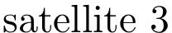
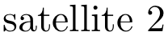
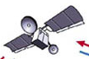


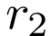
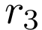
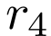
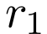

Global Positioning System
24 satellites orbiting the earth
Altitude 20,180 km
Any point on Earth’s surface can be seen by at least 4 satellites at all times
Time of flight of radio signal from 4 satellites to receiver used to trilaterate location of receiver in 3 dimensions
4 range measurements needed to account for clock offset error
4 nonlinear equations in 4 unknowns results:
latitude
longitude
altitude
receiver clock time offset

Slide 25
GPS Error Sources
Time of flight of radio signal from satellite to receiver used to calculate pseudorange
Called pseudorange to distinguish it from true range
Numerous sources of error in time of flight measurement:
Ephemeris Data – errors in satellite location
Satellite Clock – due to clock drift
Ionosphere – upper atmosphere, free electrons slow transmission of GPS signal
Troposphere – lower atmosphere, weather (temperature and density) affect speed of light, GPS signal transmission
Multipath Reception – signals not following direct path
Receiver Measurement – limitations in accuracy of receiver timing
Small timing errors can result in large position errors
10 ns timing error → 3 m pseudorange error

Slide 26
GPS Error Characterization
Cumulative effect of GPS pseudorange errors is described by user equivalent range error (UERE)
UERE has two components
Bias
Random

Slide 27
GPS Error Characterization
Effect of satellite geometry on position calculation is expressed by Dilution of Precision (DOP)
Satellites close together → high DOP
Satellites far apart → low DOP
DOP varies with time
Horizontal DOP is smaller than vertical DOP
Nominal HDOP = 1.3
Nominal VDOP = 1.8

Slide 28
Total GPS Error (RMS)
Notes:
Standard deviation of RMS error in the north-east plane:
\begin{align*}
E_{\text{n-e,rms}} &= \text{HDOP} \times \text{UERE}_{\text{rms}} \\
&= (1.3)(5.1\text{ m}) \\
&= 6.6\text{ m}
\end{align*}
\vspace{1cm}
Standard deviation of RMS altitude error:
\begin{align*}
E_{\text{h,rms}} &= \text{VDOP} \times \text{UERE}_{\text{rms}} \\
&= (1.8)(5.1\text{ m}) \\
&= 9.2\text{ m}
\end{align*}

Slide 29
GPS Error Model

Slide 30
GPS Gauss Markov Process Error Model

Slide 31
Project
Add sensor models to the simulation

